Slide 1
Sudoku Solver

Slide 2
What you have learned...
What you will need...
Data types
integer, string, boolean, float
Data Structures
Lists, that’s pretty much it
IF / ELIF / ELSE Statments
FOR / WHILE loops
Functions
Objects (classes)

Slide 3
Quick Review – Data Types
Strings: surrounded with quotation marks (“ “) a string is a bunch of characters, i.e. “Python is awesome.”
Integers: numeric natural numbers, i.e. 1 or 2 or 3 or 4 or 19999
Boolean: True / False values, denoted in python by True or False

Slide 4
Data Types
Lists: denoted by [ and ], lists can hold... lists of things. i.e.
[1, 3, True, “dane”]
List/String indexing: finding out what is in the list or string at a certain position. i.e.
my_list = [“Dane”, “Parker”, “Jenna”]
# printing my_list[0] will print ‘Dane’
# printing my_list[1] will print ‘Parker’
# printing my_list[2] will print ‘Jenna’
#printing “jenna”[3] will print ‘n’

Slide 5
IF / ELIF / ELSE
IF [conditional]: where a conditional is something that returns a Boolean value. i.e.
if 5 == 5:
print(“The numbers are equal”)
if 6 > 5:
print(“6 is greater than 5”)
ELIF [conditional]: where conditional is the same as above, this statement is optional and runs if the preceding IF statement’s conditional value was False
elif (5+5) == 10:
print(“5 plus 5 is equal to 10”)
ELSE: no conditional in this one, this statement is optional and runs if the preceding if and elif’s conditional values were all False
else:
print(“Nothing was true”)

Slide 6
FOR / WHLE loops
FOR: can be ‘FOR’ or ‘FOR EACH’, loops a specified amount of times and executes it’s corresponding block of code. i.e.
For number in range(0,11):
print(number) # would print 0 1 2 3 4 5 6 7 8 9 10
For each char in “Python”:
print(char) # would print P y t h o n
WHILE [conditional]: while something is true, do stuff.
while x < 10: # assume x = 0 initially
print(“x is: “, x) # prints 0, 1, 2, 3, 4, 5, 6, 7, 8, 9
x = x + 1 # increment x to avoid infinite while loop

Slide 7
functions
functions are used to re-use code that you will need multiple times in a program, and to organize code.
def my_function():
num1 = 5
num2 = 2
return num1 + num2
Functions can also have arguments... i.e.
def cool_function(name, age):
if len(name) < 5:
print(“you have a short name”)
if age > 40:
print(“you old”)
To call a function...
result = my_function() # the number 7 will be stored in result

Slide 8
Objects
Objects are things you see / use every day, your car, a student, a computer..
Objects in python are just collections of data and things that can be done to that data that describe something
A TTU Student has a name, a R#,...
class Student(Object):
def __init__(self, name, r_no, major, classification):
self.name = name
self. r_no = r_no
def set_r_no(self, new_r_no):
self.r_no = new_r_no
def get_r_no(self):
return self.r_no
To create a student object:
student_dane = Student(“Dane Lowrey”, “123456789”)

Slide 9
Algorithms
Algorithms are important to problem solving
An algorithm is a list of steps you need to take to do something
an algorithm for making a sandwich:
get out 2 slices of bread
get out 1 slice of cheese
get out desired meat
put meat on top of one piece of bread
put cheese on top of meat
put other piece of bread on top of cheese
Of course your algorithm may be different from mine.
Algorithms are in English, but are implemented using all that you have learned in python code so that the computer can understand and solve problems

Slide 10
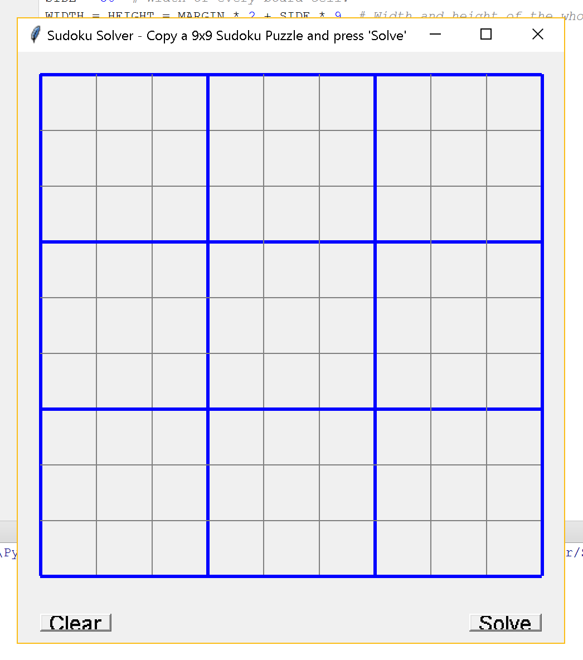
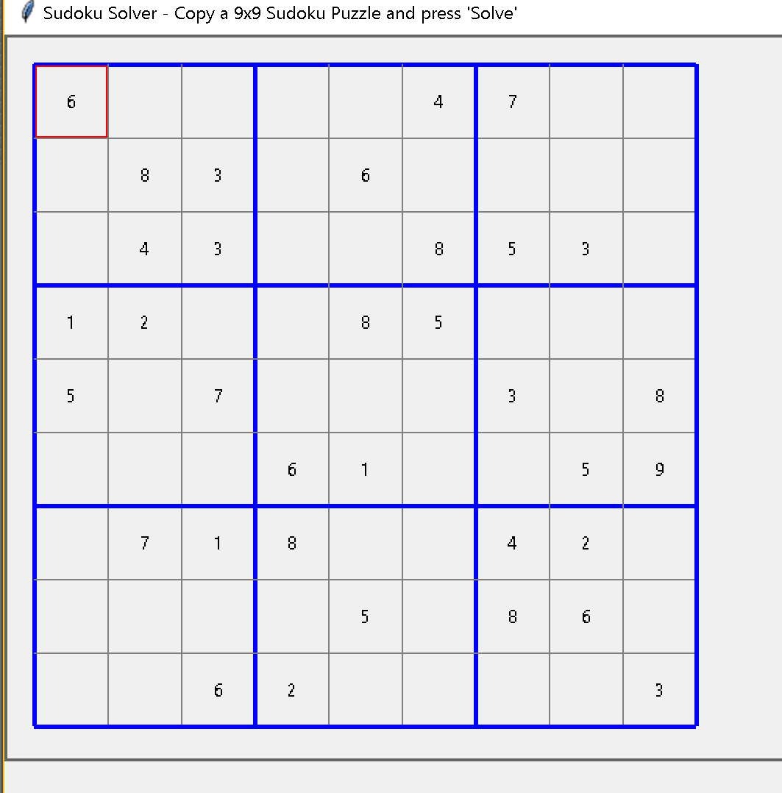

Slide 11
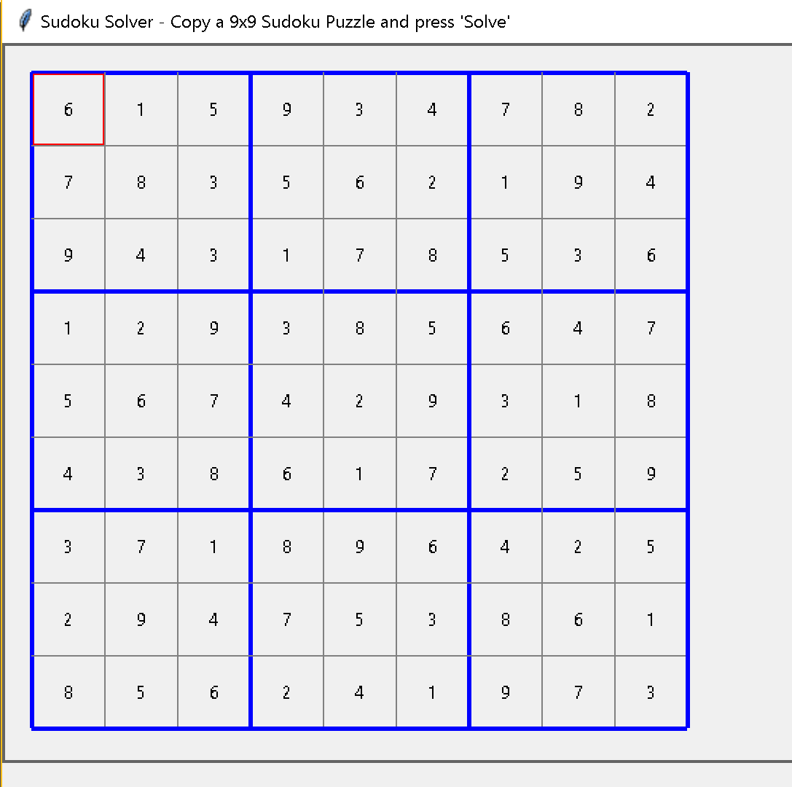

Slide 12
Terms we will be using
Board: the 9x9 sudoku board
Row: a horizontal 9 cells on the board (there are 9 rows)
Column: a vertical 9 cells on the board (there are 9 columns)
Cell: a single, individual square on the 9x9 sudoku board, (there are 81 of them)
Box: a square made up of 9 cells, (3 rows and 3 columns of length 3), there are (there are 9 of them)
Affected Cell: a cell that is affected by the placement of a value in another cell in the same row or column
Possible Numbers: the list of possible valid numbers for an individual cell

